Slide 1

Highlights from the NSBA Legal Advocacy Update
___________________________________________________________________________________
School Law Practice Seminar
October 20, 2017
Chicago, IL
Francisco M. Negrón, Jr.
Chief Legal Officer
http://www.nsba.org/cosa

Slide 2
SCOTUS
Circuit Cases
Civil Rights Enforcement
Federal Statutes and Regulations
Immigration Enforcement
Notes:
Not time for everything – not overtime rule, ACA reform bill (Medicaid cuts), withdrawal of guidance on joint employers and joint employers case petitioned from 4th Circuit. AND TAKING OUT ORAL ARGUMENT.
AKA, SCOTUS, POTUS and COTUS
Fry and Endrew F very generally and one to keep an eye on
Federal budget news – free lunch, after school programs, Title I – in jeopardy?
Civil Rights – What is OCR actually going to enforce? Cases to watch
Federal Regs – ESSA state plans, regs that were rescinded,
NOT addressing many many federal issues: ACA repeal proposals, E-rate, infrastructure “talk” below, wellness policies (also below) – because no change imminent
School Infrastructure
Administration and Congress have announced proposals to invest in infrastructure, including our schools.
Administration: “Pursue an ‘America’s Infrastructure First’ policy that supports investments in transportation, clean water, a modern and reliable electricity grid, telecommunications, security infrastructure, and other pressing domestic infrastructure needs.
Democratic proposal: $75B to jumpstart public school modernization with funds distributed on a formula basis to public schools with the greatest and most urgent needs. “Funding will ensure that school construction and modernization projects can get underway quickly without placing an undo financial burden on local taxpayers.”
The final rule requires LEAs to begin developing a revised local school wellness policy during School Year 2016-2017. LEAs must fully comply with the requirements of the final rule by June 30, 2017. This includes, but is not limited to:
Permitting parents, students, representatives of the school food authority, teachers of physical education, school health professionals, the school board, school administrators, and the general public to participate in the development, implementation, review, and update of the local wellness policy.
Identifying wellness policy leadership of one or more LEA and/or school official(s) who have the authority and responsibility to ensure each school complies with the policy.
Informing and updating the public (including parents, students, and others in the community) about the content and implementation of the local wellness policy.
Ensuring the wellness policy includes all of the required components:
Specific goals for nutrition promotion and education, physical activity, and other school-based activities that promote student wellness. LEAs are required to review and consider evidence-based strategies in determining these goals.
Nutrition guidelines for all foods and beverages available or for sale on the school campus during the school day that are consistent with Federal regulations for:
School meal nutrition standards, and
Smart Snacks in School nutrition standards.
Policies for other foods and beverages available on the school campus during the school day (e.g., in classroom parties, classroom snacks brought by parents, or other foods given as incentives).
Policies for food and beverage marketing that allow marketing and advertising of only those foods and beverages that meet the Smart Snacks in School nutrition standards.
Description of public involvement, public updates, policy leadership, and evaluation plan.
All LEAs must assess their wellness policy at least once every three years on the extent to which schools are in compliance with the district policy, the extent to which the local wellness policy compares to model local school wellness policies, and the progress made in attaining the goals of the local wellness policy. LEAs must make this assessment available to the public.

Slide 3
SCOTUS
Notes:
More about Gorsuch’s rise to the Court at the larger conference tomorrow. Only prior clerk to be sworn in by, and serve with, Justice for whom he clerked.

Slide 4
October 2016 Term: Key Cases for Public Schools
Fry v. Napoleon Comm. Sch., 137 S.Ct. 743 (2017)
Endrew F. v. Douglas Cnty. Dist. Re-1, 137 S.Ct. 988 (2017)
Trinity Lutheran Church of Columbia, Inc. v. Comer, 137 S.Ct. 2012 (2017)

Slide 5

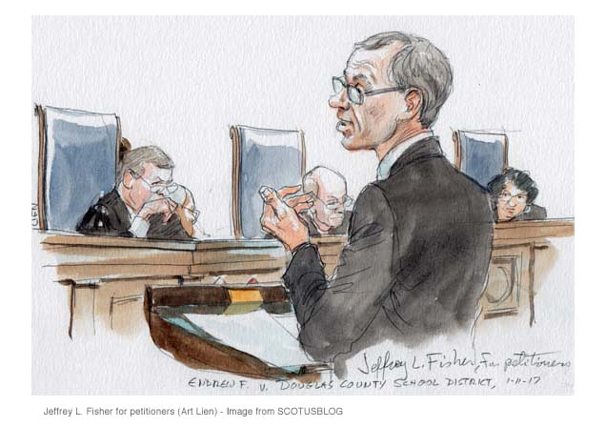
Two Special Education Cases In One Year
Fry v. Napoleon Comm. Sch., 137 S.Ct. 743 (2017)
Endrew F. v. Douglas Cnty. Dist. Re-1, 137 S.Ct. 988 (2017)
Both pre-Gorsuch = 8 justices
Notes:
Fry Feb. 22
Endrew F. March 23
But there is a Gorsuch connection.

Slide 6
Are you exhausted yet?
Notes:
It’s not a service animal case.

Slide 7
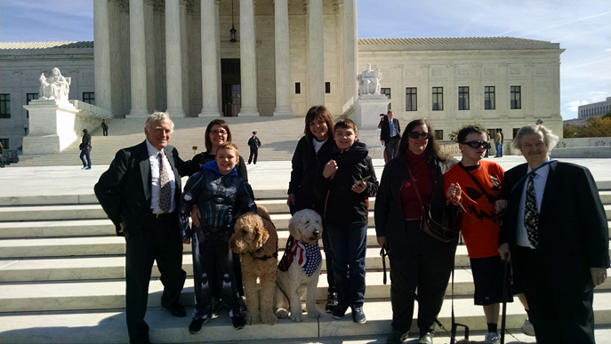
Fry v. Napoleon Comm. Sch., 137 S.Ct. 743 (2017)
NSBA amicus brief highlights:
IDEA’s long-standing exhaustion requirement must be interpreted in the context of its collaborative framework -- A direct route to litigation undermines the IDEA’s collaborative process for resolving special education disputes.
Weakening IDEA’s
exhaustion requirement
would undermine the
collaborative framework.
Notes:
It’s easy to frame a claim as non-educational, and that relief is not available under IDEA, thereby avoiding the collaborative process.
THE IDEA’S LONG-STANDING EXHAUSTION REQUIREMENT MUST BE INTERPRETED IN THE CONTEXT OF ITS COLLABORATIVE FRAMEWORK ................
Allowing Students and Parents To Proceed Directly to Court to Pursue Damages Claim Under Section 504 or the ADA Without Exhausting Administrative Processes Directly Contravenes the Intent of Congress...........................................................
B. Congress Consistently and Clearly Has Required Exhaustion in Disputes About Services for Students with Disabilities ...........
II. WEAKENING THE IDEA’S EXHAUSTION REQUIREMENT WOULD UNDERMINE THE COLLABORATIVE FRAMEWORK CONGRESS DESIGNED TO RESOLVE EDUCATIONAL MATTERS CONCERNING STUDENTS WITH DISABILITIES ..............
Allowing Parents to Pursue ADA and Section 504 Claims Without First Exhausting IDEA Procedures Will Fundamentally Alter the IEP Process
Allowing Circumvention of IDEA’s Due Process Procedures to Provide Direct Access to Federal Courts Would Forfeit the Benefits of the Administrative Scheme Congress Designed for Resolving Disputes about Appropriate Programs and Services for Students with Disabilities

Slide 8
Fry v. Napoleon Comm. Sch., 137 S.Ct. 743 (2017)
The court reversed 8-0, in an opinion by Justice Kagan on February 22, 2017, holding:
(1) Exhaustion under IDEA is unnecessary when “gravamen” of suit is something other than denial of FAPE, as relief for denial of FAPE is the only relief IDEA makes available;
(2) Case remanded to determine whether the gravamen of complaint-- which alleges only disability-based discrimination without reference to adequacy of special-education services -- seeks relief for denial of a FAPE.

Slide 9
Fry v. Napoleon Comm. Sch., 137 S.Ct. 743 (2017)
SCOTUS Noted:
Plaintiff must first use the IDEA’s administrative proceedings only if she contends that she has been denied FAPE.
A hearing officer is limited in relief awarded in an IDEA proceeding.
If a plaintiff must begin with the IDEA proceedings only when she is alleging that she has been denied a FAPE, the court continued, how are courts supposed to decide when the plaintiff is seeking relief for the denial of a FAPE and when she is not?

Slide 10
Fry v. Napoleon Comm. Sch., 137 S.Ct. 743 (2017)
SCOTUS Guidance on Cases That Don’t Require Exhaustion:
Courts should pose “a pair of hypothetical questions:
First, could the plaintiff have brought essentially the same claim if the alleged conduct had occurred at a public facility that was not a school—say, a public theater or library?
And second, could an adult at the school—say, an employee or visitor—have pressed essentially the same grievance?”
If YES then “a complaint that does not expressly allege the denial of a FAPE is also unlikely to be truly about [the IDEA].” No exhaustion necessary.

Slide 11
Fry v. Napoleon Community Schools, 137 S.Ct. 743 (2017)
What the decision means for schools:
Easier pathway to litigation
May affect how your special education staff document services provided under ADA v. IDEA.
Be clear about nature of service.
If service is substantive in nature, or related closely to a substantive academic service, articulate that clearly in the IEP. Parent concurrence about nature of service may be useful in subsequent hearing.
If service is about access, and clearly not about the provision of a substantive educational service, think about notating the distinction.

Slide 12
Fry v. Napoleon Community Schools, 137 S.Ct. 743 (2017)
What the decision means for school attorneys:
Easier pathway to litigation means there will be more cases, and new routes created.
J.M. v. Francis Howell Sch. Dist., 850 F.3d 944 (8th Cir. 2017)
Claim brought under 504, ADA + for compensatory and punitive damages
Exhaustion required in R&S case
Court found claim about how use of isolation and restraints failed to provide proper and sufficient supportive services to permit child to benefit from instruction was NOT alleging discrimination, but a denial of FAPE
“The complaint here shows the IEP is a central dispute of this litigation.” (internal quotations omitted)
Notes:
J.M. – original complaint had actually included claims under IDEA.

Slide 13
Some Benefit… or Some Benefit?
Notes:
“It says "some benefit," but you're -- you're reading it as saying "some benefit," and the other side is reading it as saying "some benefit,“” …. And it makes a difference.”
- CHIEF JUSTICE ROBERTS

Slide 14
Endrew F. v. Douglas Cnty. Dist. Re-1, 137 S.Ct. 988 (2017)
NSBA Amicus Brief highlights:
Reading a higher substantive educational benefit standard into IDEA in effect would be legislating from the bench. As it did in Arlington Central Sch. Dist. v. Murphy, 548 U.S. 291 (2006), another IDEA case, the Court should avoid expanding statutory definitions to meet policy goals that are within the authority of the legislative branch to set.
Notes:
CONGRESS INTENDED TO DEFER TO STATES AND LOCAL EDUCATIONAL AGENCIES THE ESSENTIAL TASKS OF IMPROVING EDUCATIONAL OUTCOMES FOR STUDENTS
By Design the IDEA’s IEP Requirements Ensure that Each Child Receives the Educational Benefits Envisioned by Congress Consistent with Rowley
The comprehensive and collaborative IEP process is uniquely applied to each disabled child
2. IEPs must set forth a comprehensive educational program tailored to each child’s individualized needs
3. Implementation of the IEP includes progress reporting, ongoing review and periodic re-evaluation
4. Development of an IEP is a complex and fact specific endeavor not amenable to the application of an artificial national standard
5. The IEP process under the Rowley standard has yielded significant improvement in the education of children with disabilities
B. A New National “Standard” Would Deprive Students of the Benefits of Individualized Consideration by Shifting the IEP Team’s Focus Away from the Fine Points of a Child’s Disability to Artificial Legal Constructs
A heightened FAPE standard will interfere with the collaborative IEP process by injecting an unmanageable degree of uncertainty
2. Departing from the current FAPE standard would create the inaccurate perception the IEPs valid under the Rowley standard shortchange students with disabilities
3. An expansion of the legal standard applied to educational benefit would negatively impact the willingness of IEP teams to place children with disabilities in the least restrictive environment
II. IMPOSING A NEW FAPE STANDARD WOULD VIOLATE THE SPENDING CLAUSE BY FAILING TO PROVIDE STATE AND LOCAL EDUCATION AGENCIES WITH APPROPRIATE NOTICE OF THE SCOPE OF THEIR OBLIGATIONS UNDER THE IDEA AND THEIR ACQUIESCENCE TO A NATIONAL EDUCATION STANDARD
Congress Has Provided No Clear Notice that the FAPE Standard Has Been Heightened Beyond the Rowley Standard
Requiring that IEPs contain measurable annual goals and the participation of students with disabilities in statewide assessments does not evince congressional intent to heighten the FAPE standard
2. IDEA amendments adding transition services to IEP requirements fall far short of demonstrating clear notice of Congress’ adoption of a heightened FAPE standard
B. The IDEA’s Deference to States and Local Education Agencies Is the Fundamental Construct Underlying the States’ Agreement To Comply With Its Expansive Statutory and Regulatory Requirements in Exchange for Federal Funds..

Slide 15
NSBA Amicus Brief highlights (cont’d):
Congress intended to defer to states and local school districts on educational decisions for individual students.
Schools are meeting students' needs above any "more then merely de minimis" standard.
A new FAPE standard expanding the Court's ruling in Bd of Educ. v. Rowley would not meet the notice requirements of the Spending Clause jurisprudence. Such a change should be left to Congress.
Notes:
The current IEP process is a collaborative framework that has worked well for several decades to ensure that students receive educational plans uniquely tailored to their needs
CONGRESS INTENDED TO DEFER TO STATES AND LOCAL EDUCATIONAL AGENCIES THE ESSENTIAL TASKS OF IMPROVING EDUCATIONAL OUTCOMES FOR STUDENTS
By Design the IDEA’s IEP Requirements Ensure that Each Child Receives the Educational Benefits Envisioned by Congress Consistent with Rowley
The comprehensive and collaborative IEP process is uniquely applied to each disabled child
2. IEPs must set forth a comprehensive educational program tailored to each child’s individualized needs
3. Implementation of the IEP includes progress reporting, ongoing review and periodic re-evaluation
4. Development of an IEP is a complex and fact specific endeavor not amenable to the application of an artificial national standard
5. The IEP process under the Rowley standard has yielded significant improvement in the education of children with disabilities
B. A New National “Standard” Would Deprive Students of the Benefits of Individualized Consideration by Shifting the IEP Team’s Focus Away from the Fine Points of a Child’s Disability to Artificial Legal Constructs
A heightened FAPE standard will interfere with the collaborative IEP process by injecting an unmanageable degree of uncertainty
2. Departing from the current FAPE standard would create the inaccurate perception the IEPs valid under the Rowley standard shortchange students with disabilities
3. An expansion of the legal standard applied to educational benefit would negatively impact the willingness of IEP teams to place children with disabilities in the least restrictive environment
II. IMPOSING A NEW FAPE STANDARD WOULD VIOLATE THE SPENDING CLAUSE BY FAILING TO PROVIDE STATE AND LOCAL EDUCATION AGENCIES WITH APPROPRIATE NOTICE OF THE SCOPE OF THEIR OBLIGATIONS UNDER THE IDEA AND THEIR ACQUIESCENCE TO A NATIONAL EDUCATION STANDARD
Congress Has Provided No Clear Notice that the FAPE Standard Has Been Heightened Beyond the Rowley Standard
Requiring that IEPs contain measurable annual goals and the participation of students with disabilities in statewide assessments does not evince congressional intent to heighten the FAPE standard
2. IDEA amendments adding transition services to IEP requirements fall far short of demonstrating clear notice of Congress’ adoption of a heightened FAPE standard
B. The IDEA’s Deference to States and Local Education Agencies Is the Fundamental Construct Underlying the States’ Agreement To Comply With Its Expansive Statutory and Regulatory Requirements in Exchange for Federal Funds..

Slide 16
Endrew F. v. Douglas Cnty. Dist. Re-1, 137 S.Ct. 988 (2017)
SCOTUS held March 22 in an 8-0, measured decision with no concurrences:
Rowley “ … is markedly more demanding than the ‘merely more than de minimis’ test applied by the Tenth Circuit.”
[IDEA] guarantees a substantively adequate program of education to all eligible children.
Require IEP to “be appropriately ambitious in light of his circumstances.”
Notes:
Court handed down an expansion, clarification of how the Rowley FAPE standard applied to a child who is not fully integrated in the regular classroom and not able to achieve on grade level.

Slide 17
Endrew F. v. Douglas Cnty. Dist. Re-1, 137 S.Ct. 988 (2017)
No “bright-line rule.”
Not a new FAPE standard, but an expansion of Rowley, which “had no need to provide concrete guidance with respect to a child who is not fully integrated in the regular classroom and not able to achieve on grade level.”
Court expressly rejected equality of opportunity standard requested by parents.
Declined to do what Congress has not done since passage of IDEA and Rowley.
Notes:
Rowley rejected the “equal opportunity” standard adopted by the lower courts, concluding that “free appropriate public education” was a phrase “too complex to be captured by the word ‘equal’ whether one is speaking of opportunities or services.”
“Mindful that Congress (despite several intervening amendments to the IDEA) has not materially changed the statutory definition of a FAPE since Rowley was decided, we decline to interpret the FAPE provision in a manner so plainly at odds with the Court’s analysis in that case.”

Slide 18
Endrew F. v. Douglas Cnty. Dist. Re-1, 137 S.Ct. 988 (2017)
“To meet its substantive obligation under the IDEA, a school must offer an IEP reasonably calculated to enable a child to make progress appropriate in light of the child’s circumstances. The ‘reasonably calculated’ qualification reflects a recognition that crafting an appropriate program of education requires a prospective judgment by school officials. ... The Act contemplates that this fact-intensive exercise will be informed not only by the expertise of school officials, but also by the input of the child’s parents or guardians. ... Any review of an IEP must appreciate that the question is whether the IEP is reasonable, not whether the court regards it as ideal.”

Slide 19
Endrew F. v. Douglas Cnty. Dist. Re-1, 137 S.Ct. 988 (2017) - THOUGHTS ON IMPLEMENTATION
Individualized treatment. “[F]ocus on the particular child is at the core of the IDEA…”
IEP should contain an analysis of progress “in light of the child’s circumstances.”
If progress is not attainable state why. What undergirds determination?
Note: If it is not a reasonable prospect for a student, “IEP need not aim for grade level.”
Notes:
In webinar, we asked how many of the attendees had received inquiries related to these decisions. Very few had.

Slide 20
Endrew F. v. Douglas Cnty. Dist. Re-1, 137 S.Ct. 988 (2017) - THOUGHTS ON IMPLEMENTATION
Families may request review of IEPs and progress.
The decision provides much deference to educational judgements of school authorities. If a case gets to a court, the school will have to show “a cogent and responsive explanation for their decisions.”

Slide 21

?
FAPE is not currently defined in IDEA or its regulations re: level of educational benefit. Should it be?
Members of COSA’s IDEA Reauthorization Working Group have been considering this question.
Potential Congressional action?

Slide 22
“A little case about tire scraps and playgrounds…”
Notes:
The Atlantic
The major church-state case could potentially expand the legal understanding of the free-exercise clause of the First Amendment of the U.S. Constitution. It is also the first time the Supreme Court has ruled that governments must provide money directly to a house of worship, which could have implications for future policy fights—including funding for private, religious charter schools.
“As Sotomayor predicts, Trinity Lutheran is likely the beginning of a new wave of legal challenges about government funds and the free-exercise clause. A little case about tire scraps and playgrounds just set the stage for a new way of thinking about the separation of church and state.se.

Slide 23
Trinity Lutheran Church of Columbia, Inc. v. Comer, 137 S.Ct. 2012 (2017)
Argued April 19, 2017
Question: Does Missouri’s practice of excluding religious entities from a playground- surfacing program violate the federal constitution’s Free Exercise (1st Amendment) protection?
Facts: Church was denied state playground funds because of its religious mission, reflecting state constitution’s restriction on state aid to religious institutions.
Notes:
Court scheduled oral argument once it seemed likely there would be a 9th justice to hear it.

Slide 24
Trinity Lutheran Church of Columbia, Inc. v. Comer, cont’d
Why it’s important:
The Court re-examines direct state and local government funding to religious institutions.
The Court explores the “play in the joints” between the Free Exercise and Establishment Clauses.
Although the dissent distinguishes this case from the line of decisions about indirect aid programs (Zelman, see FN2), the majority’s Free Exercise analysis might be used to argue expansion of some state voucher programs.

Slide 25
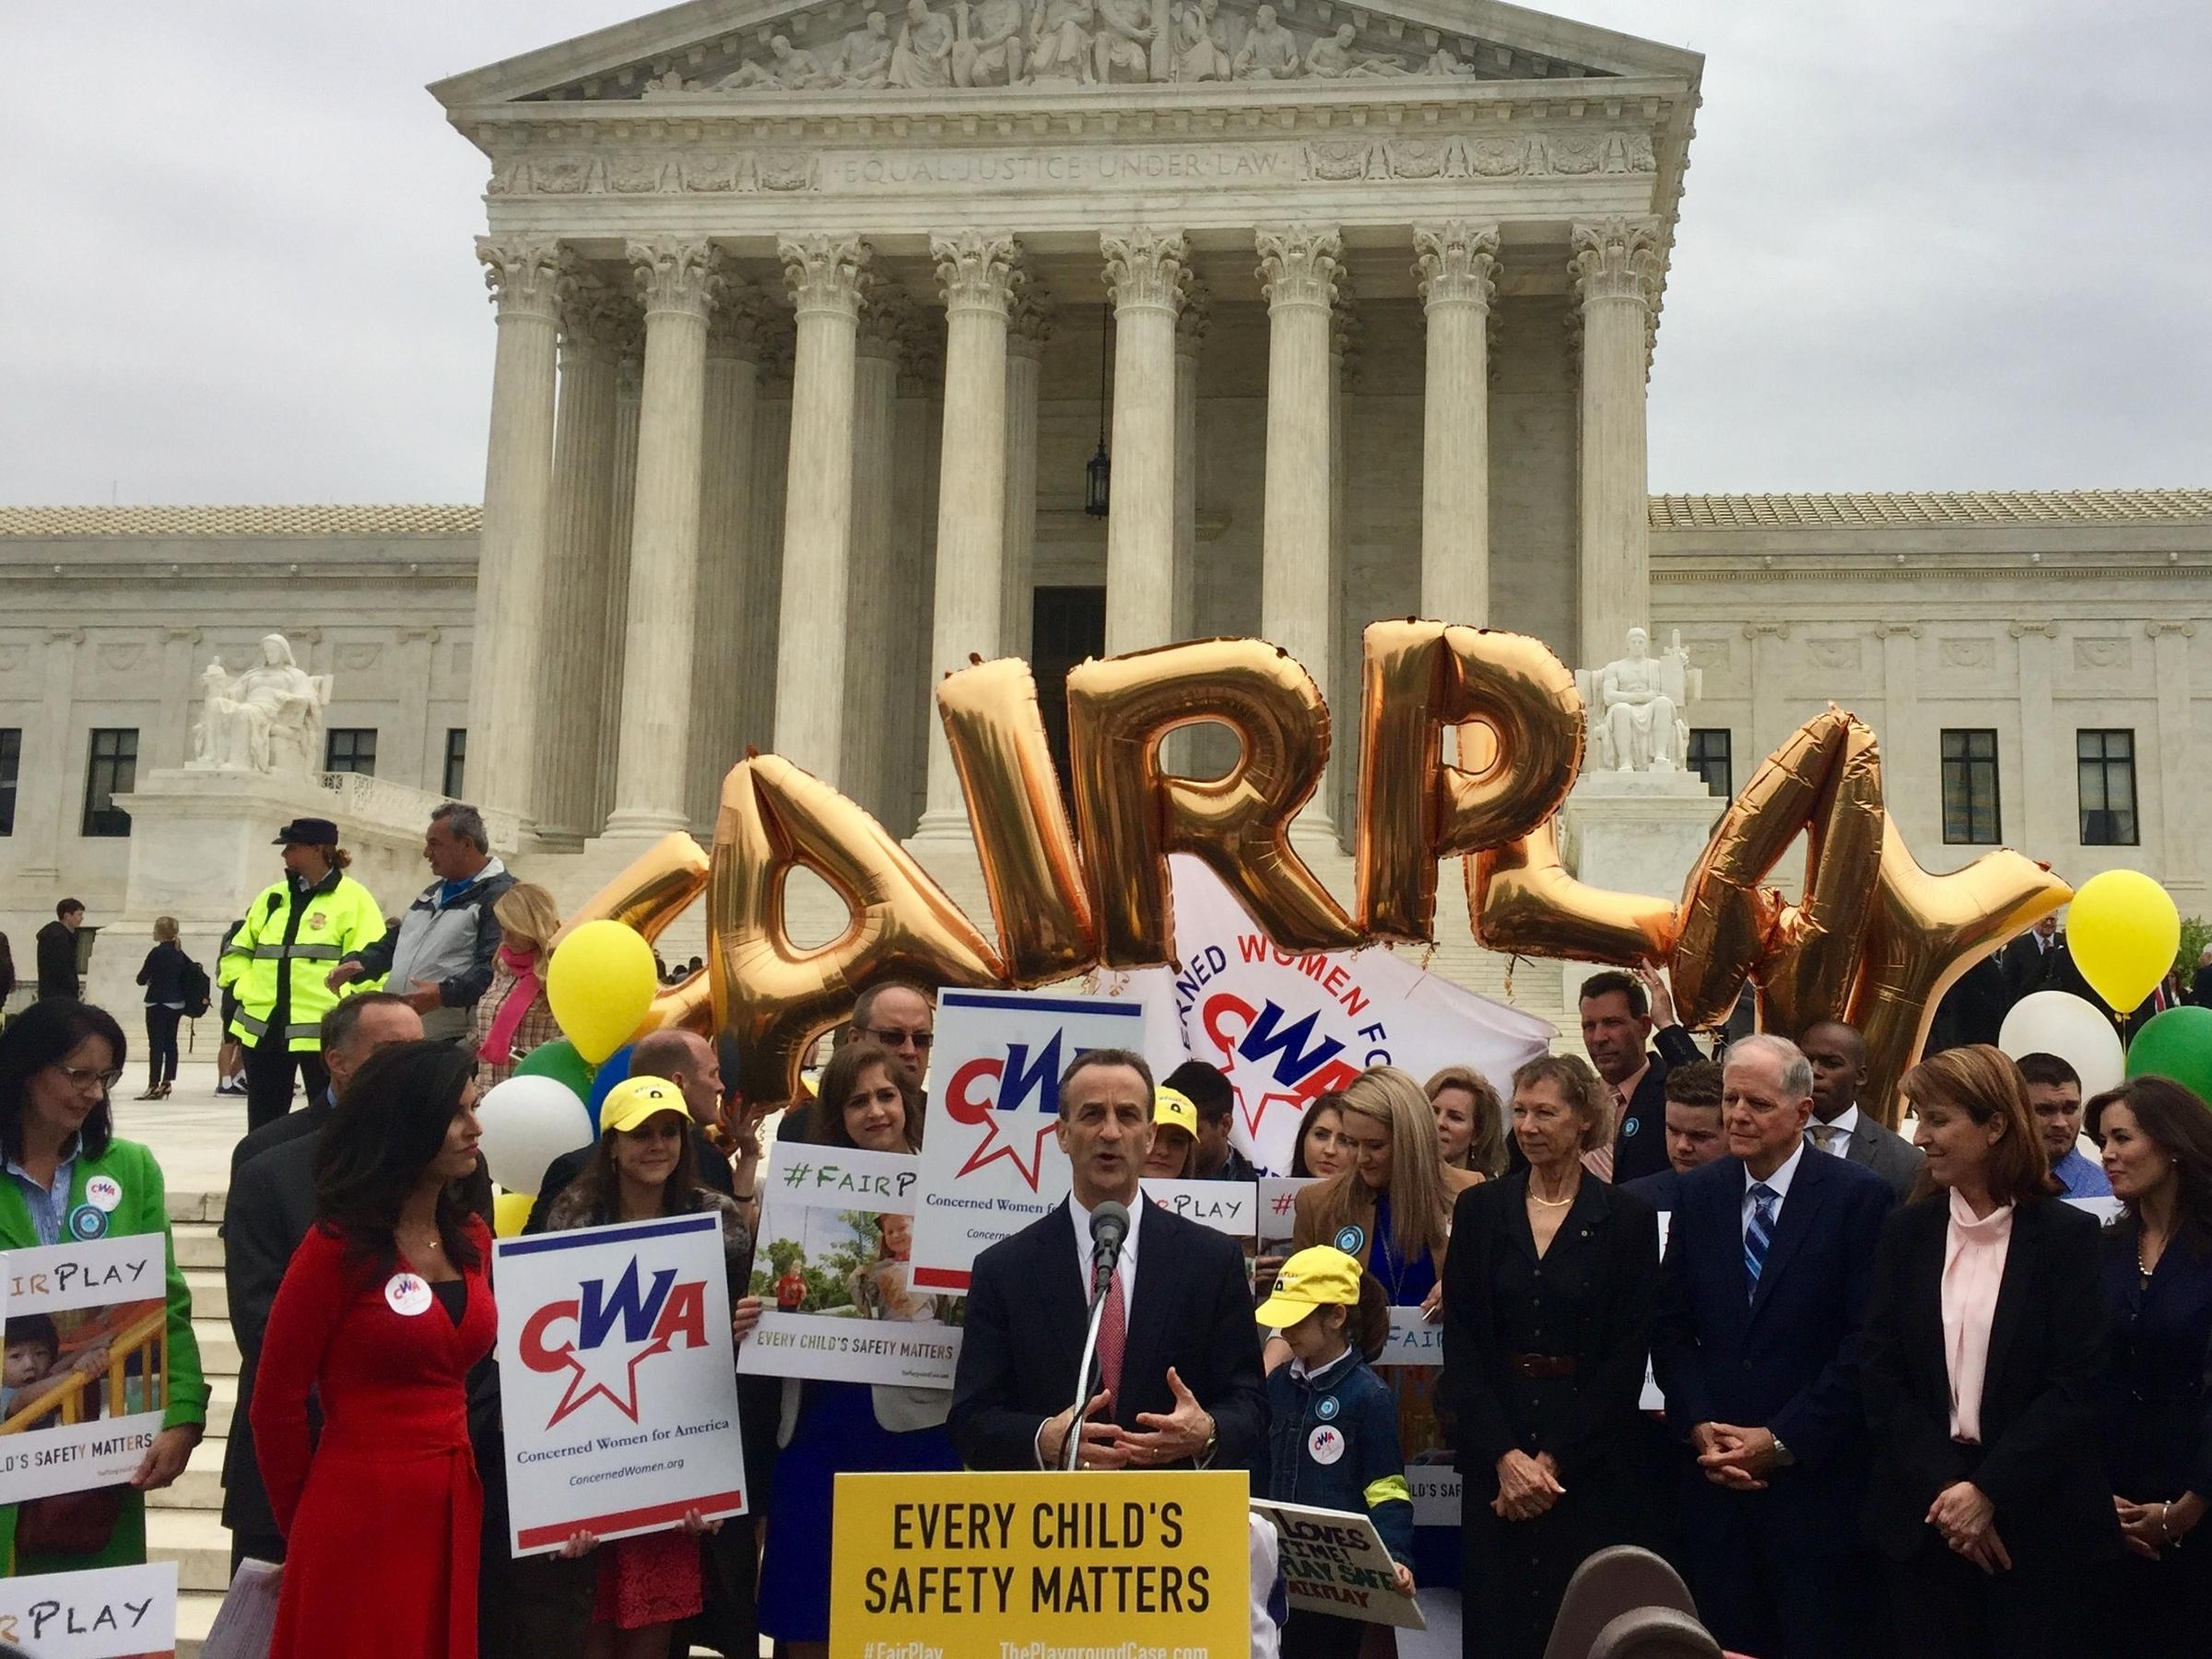
Trinity Lutheran and public schools
39 state constitutions have “Blaine Amendments” –barring government aid to religion.
Missouri’s: “No money shall ever be taken from the public treasury, directly or indirectly, in aid of any church, sect, or denomination or religion”
Have been barriers to
vouchers and tax credit
programs and have been
relied upon to exclude
religious schools
Notes:
This decision could open the way to widespread challenges to the application of Blaine Amendments.
But recent decisions in state supreme courts have upheld savings account/voucher programs despite these provisions, finding funds become parents’ once awarded.

Slide 26
Trinity Lutheran Church of Columbia, Inc. v. Comer, HOLDING
7-2
CJ Roberts wrote for the majority (Except as to FN3), joined by Kennedy, Kagan, Alito, with concurrences by Gorsuch (joined by Thomas) and Breyer
Sotomayor dissented (joined by Ginsburg)
Held: State’s policy of expressly denying a qualified religious entity a public benefit solely because of its religious character “goes too far.” State’s interest in “skating as far as possible from religious establishment concerns” not enough to survive strict scrutiny of this penalty imposed on the free exercise of religion.
Notes:
The Atlantic:
“As Sotomayor predicts, Trinity Lutheran is likely the beginning of a new wave of legal challenges about government funds and the free-exercise clause. A little case about tire scraps and playgrounds just set the stage for a new way of thinking about the separation of church and state.se.

Slide 27
Trinity Lutheran Church of Columbia, Inc. v. Comer, HOLDING cont’d
Footnote 3 attempts to limit the holding:
“This case involves express discrimination based on religious identity with respect to playground resurfacing. We do not address religious uses of funding or other forms of discrimination.”
But only 4 justices signed on to FN3 – so it’s not part of the “majority.”

Slide 28
Trinity Lutheran Church of Columbia, Inc. v. Comer, HOLDING cont’d
Majority: Distinguished Locke by noting that case turned on what the scholarship recipient intended to do with the public funds – pursue a religious degree. “Here, … [the church] was denied a grant simply because of what it is – a church.” “In this case, there is no dispute that Trinity Lutheran is put to the choice between being a church and receiving a government benefit.”
Gorsuch and Thomas concurring: doubtful of the stability of legal theory distinguishing between “laws that discriminate on the basis of religious status and religious use.”
Breyer concurring: would limit the holding to public programs designed to secure or to improve the health and safety of children – akin to police and fire.
Notes:
Gorsuch and Thomas would have gone farther – NOT distinguishing between the religious use and religious status. All should be allowed funding.
Breyer would limit the holding to safety realm and leave the Free Exercise analysis of other kinds of public benefits for another day.
Atlantic: Breyer seemed to be anticipating the floodgate of legal challenges that Trinity Lutheran may invite. This is the first time the court has said the government is required to provide public funding directly to a religious organization. That decision could have implications for a host of other policy fights—especially the debate over public funding for private religious schools. In her dissent to the majority’s decision, joined by Justice Ruth Bader Ginsburg, Sonia Sotomayor wrote that this was her great fear about this decision.

Slide 29
Trinity Lutheran Church of Columbia, Inc. v. Comer, HOLDING cont’d
Sotomayor and Ginsburg dissenting:
“This case is about nothing less than the relationship between religious institutions and the civil government – that is, between church and state. The Court today profoundly changes that relationship by holding, for the first time, that the constitution requires the government to provide public funds directly to a church.”
Court should have invoked the Establishment Clause itself, rather than following the parties’ agreement that it didn’t prevent Missouri from including the church in the program. Establishment Clause bars Missouri from granting the church’s funding request because it uses the school in conjunction with its religious mission.
“The government may not directly fund religious exercise.”
Establishment Clause precedent says key issue is whether public funds subsidize religion, not whether the approach is “secular and neutral.”
Notes:
The government cannot deny churches public funding merely because they are churches, but the government may deny them funding if they would use it for religious endeavors.
Goes through long line of historical cases and state action removing their own religious assessment laws. Direct public funding not allowed when the funds will be used for religious activity.
Atlantic
While her colleagues may see this about nothing more than tire scraps on a church playground, Sotomayor argued that the decision undermines years of court precedent and legal history in the United States. She walked through case after case of the early American states limiting the flow of public money to houses of worship.
“If this separation [of church and state] means anything, it means that the government cannot … tax its citizens and turn that money over to houses of worship,” Sotomayor wrote. “The Court today blinds itself to the outcome this history requires and leads us instead to a place where separation of church and state is a constitutional slogan, not a constitutional commitment.”
As Sotomayor predicts, Trinity Lutheran is likely the beginning of a new wave of legal challenges about government funds and the free-exercise clause. A little case about tire scraps and playgrounds just set the stage for a new way of thinking about the separation of church and state.

Slide 30
Cert. Granted and Remanded

Slide 31
School Choice Cases Petitions Granted and Remanded post-Trinity Lutheran
New Mexico Ass’n of Non-public Schools v. Moses, 367 P.3d 838 (N.M. 2015), petition for cert. filed (U.S., May 19, 2016)
Program providing for the purchase and lending of instructional material to private schools violates the State Constitution provision prohibiting appropriation of funds to support any sectarian or private school.
Vacated and remanded to Supreme Court of New Mexico for further consideration in light of Trinity Lutheran Church of Columbia, Inc. v. Comer, 582 U. S. ___ (2017)
Notes:
remanded the Supreme Court of New Mexico for further consideration in light of Trinity Lutheran Church of Columbia, Inc. v. Comer, 582 U. S. ___ (2017)

Slide 32
School Choice Cases Petitions Granted and Remanded post-Trinity Lutheran
Colo. State Bd. of Educ. v. Taxpayers for Pub. Educ., 351 P.3d 461 (Col. 2015)
Issue: Whether requiring a state to categorically deny otherwise neutral and generally available public aid on the basis of religion violates the United States Constitution.
Douglas Cty. Sch. Dist. v. Taxpayers for Pub. Educ.
Issue: Whether Colorado’s Blaine Amendment, which the unrebutted record plainly demonstrates was born of religious bigotry, can be used to force state and local governments to discriminate against religious institutions without violating the Religion Clauses of the First Amendment and the Equal Protection Clause of the Fourteenth Amendment.
Notes:
Cases petitioned October 2015. Combined for Supreme Court of Colorado opinion below. Separated for cert. petitions.
The three petitions are all based on the Colorado Supreme Court decision. Each raises a separate issue and were filed by different petitioners but have the same respondent, Taxpayers for Public Education which brought the suit challenging the Douglas County voucher program. If the Court took up case it would have to whether to consolidate the petitions, or limit review to one or two of the issues raised.
Cases are remanded to the Supreme Court of Colorado for further consideration in light of Trinity Lutheran Church of Columbia, Inc. v. Comer, 582 U. S. ___ (2017)

Slide 33
School Choice Cases Petitions Granted and Remanded post-Trinity Lutheran
Doyle v. Taxpayers for Pub. Educ.
Issue: Whether it violates the Religion Clauses or Equal Protection Clause of the United States Constitution to invalidate a generally-available and religiously-neutral student aid program simply because the program affords students the choice of attending religious schools.
Colorado S.Ct. held the scholarship program violated state const. provision prohibiting use of public monies to aid schools controlled by religious or sectarian denomination
All three Colorado cases vacated and remanded to Supreme Court of Colorado for further consideration in light of Trinity Lutheran Church of Columbia, Inc. v. Comer. State Supreme Court remanded to trial court.
Notes:
According to a August 3, 2017 report by Marianne Goodland of The Colorado Independent, the Douglas County Board of Education's November 2017 election could determine the fate of the school district's private school voucher program. The voucher program was approved by a 4-3 vote. The seats of the four members who voted for the program are up for garbs. if opponents to the voucher program take just one of the four seats, the board would likely drop the voucher program altogether, rendering the legal case moot. . However, if voucher proponents hold their slim majority, the legal battle likely would continue.
Outside money is also expected to play a role in the race. Two years ago, Americans for Prosperity, the conservative group backed by billionaires David and Charles Koch, paid for ads that encouraged viewers to contact the board and express their support for the “school choice” (i.e. voucher) decisions. Douglas County historically has been one of the highest-achieving in the state, but over the last two years, its school board has been riven by battling between conservative education reformers and those referred to as “pro-public school.” The district, in the words of one candidate, is facing a financial crisis, with a backlog of nearly $300 million in school building repairs.
Meanwhile, Benjamin Wermund of Politico Pro reported on August 4, 2017 that the Colorado Supreme Court had remanded the Douglas County School District voucher program case back to state trial court after the case had been sent back to Colorado Supreme Court by the U.S. Supreme Court. Politico Pro noted: "The Colorado case, out of the Douglas County School District, represents school choice advocates' next best shot at scrapping constitutional provisions in 39 states known as "Blaine Amendments" that prohibit public money from aiding religious organizations, including private schools."

Slide 34
G.G. v. Gloucester Cty. Sch. Bd.
Supreme Court granted cert. October 28, 2016.
Set for oral argument in late March.
On March 6, the Supreme Court vacated the ruling of the U.S. Court of Appeals for the 4th Circuit (which had granted the student’s injunction based on the Obama administration’s position) and remanded to that Court for further consideration in light of the guidance issued by the Trump administration on February 22, withdrawing previous guidance issued by Obama administration.
On Aug. 2, 2017, the 4th Cir. Remanded to the trial court for further factual development on mootness due to graduation.
Notes:
COSA members have access to transgender litigation chart
Law continues to evolve in the courts.
Challenge to North Carolina “bathroom bill” – dropped by DOJ
Illinois case challenging resolution agreement on bathrooms
Pennsylvania court ruled for student under equal protection concept
Texas suit brought by 20+ states on hold after change in Administration’s position – dismissed
And more!
The School Board contends that this case has become moot because, after our April 2016 decision, Grimm apparently graduated from high school on June 10, 2017. The School Board argues that, absent any allegation of a “particular intention to return to school after graduation,” this change of status deprives Grimm of a continued interest in the litigation, rendering the case moot. Supp. Reply Br. of Sch. Bd. at 4; see also Supp. Br. of Sch. Bd. at 18–20. The School Board states further that its bathroom policy does not necessarily apply to alumni, and that the issue of whether the policy is applicable to alumni is not yet ripe for adjudication. In his briefing, Grimm challenges these contentions, arguing that his possible “future attendance at alumni and school-community events” establishes a concrete interest in obtaining an injunction, Supp. Br. of Pl.-Appellant at 19, and that the School Board’s “noncommittal statement” regarding the enforceability of its policy “falls far short of a representation that the Board will voluntarily cease discriminating against [him].” Supp. Reply Br. of Pl.-Appellant at 4. The School Board thus suggests an absence of our jurisdiction, while Grimm contends that we continue to have jurisdiction.
Mootness is jurisdictional and the panel does not have the necessary facts in the record. Because the case was litigated while Gavin Grimm was a student, there are no facts in the record supporting the assertions that he could return and the policy would apply. So the court remanded to the district court to determine those facts and decide whether the case has become moot.

Slide 35
Circuit Cases

Slide 36
Hively v. Ivy Tech. Community College of Indiana, 853 F.3d 339 (7th Cir. 2017)
En Banc 7th Circuit held 8-3 sexual orientation discrimination claim cognizable under Title VII.
Rejected reliance on legislative history, noting that the text of the statute and the Supreme Court's guidance were its guides:
"[T]his court sits en banc to consider what the correct rule of law is now in light of the Supreme Court's authoritative interpretations, not what someone thought it meant one, ten, or twenty years ago."
Notes:
The court's ruling in Hively v. Ivy Tech Community College of Indiana overrules a panel decision issued in July 2016 upholding the district court's decision, which had dismissed the plaintiff's complaint for failure to state a claim.

Slide 37
Hively v. Ivy Tech. Community College of Indiana, 853 F.3d 339 (7th Cir. 2017)
"The logic of the Supreme Court's decisions, as well as the common-sense reality that it is actually impossible to discriminate on the basis of sexual orientation without discriminating on the basis of sex, persuade us that the time has come to overrule our previous cases that have endeavored to find and observe that line…"
"We hold only that a person who alleges that she experienced employment discrimination on the basis of her sexual orientation has put forth a case of sex discrimination for Title VII purposes.
Notes:
The court's ruling in Hively v. Ivy Tech Community College of Indiana overrules a panel decision issued in July 2016 upholding the district court's decision, which had dismissed the plaintiff's complaint for failure to state a claim.
It was therefore wrong to dismiss Hively's complaint for failure to state a claim. The judgment of the district court is REVERSED and the case is REMANDED for further proceedings.“
Several district courts have found the distinction between a claim for discrimination based on gender stereotyping (widely held to be cognizable under Title VII) and based on sexual orientation to be the same. Using the “common sense language” from Hively, and citing it as persuasive, a New York district court recently found a claim cognizable, despite the 2nd Circuit’s holding. Philpott v. State of New York, 2017 WL 1750398 (S.D. N.Y. 2017)

Slide 38
Whitaker v. Kenosha Unif. Sch. Dist. No. 1, 858 F.3d 1034 (7th Cir. 2017)
Affirmed a Wisconsin district court's ruling granting a transgender student a preliminary injunction allowing use of restrooms according to gender identity.
The panel found that the student was likely to suffer irreparable harm, did not have an adequate remedy at law, and was likely to succeed on the merits under both Title IX and Equal Protection claims.
Notes:
3-judge panel

Slide 39
Whitaker v. Kenosha Unif. Sch. Dist. No. 1, 858 F.3d 1034 (7th Cir. 2017)
Irreparable harm absent injunctive relief:
Expert opinion that use of boys’ restrooms is integral to student’s transition and emotional well-being
Using single restrooms invited more scrutiny and attention from peers
Inadequate remedies at law:
Rejected school district’s analogy to tort damages
Notes:
3-judge panel

Slide 40
Whitaker v. Kenosha Unif. Sch. Dist. No. 1, 858 F.3d 1034 (7th Cir. 2017)
Reasonable likelihood of success on the merits (Title IX):
Sex-stereotyping claim under Title VII recognized by SCOTUS in Price Waterhouse and Oncale, and by Seventh Circuit in Hively.
Sixth Circuit has recognized transgender plaintiff’s ability to bring sex-stereotyping claim under Title VII. (Smith v. City of Salem, 378 F.3d 566 (2004)).
“A policy that requires an individual to use a bathroom that does not conform with his or her gender identity punishes that individual for his or her gender-nonconformance, which in turn violated Title IX.”
Notes:
3-judge panel
Rejected school district’s argument that Ash could not “unilaterally declare” his gender. He has a medically diagnosed and documented condition.

Slide 41
Whitaker v. Kenosha Unif. Sch. Dist. No. 1, 858 F.3d 1034 (7th Cir. 2017)
Reasonable likelihood of success on the merits (Equal Protection):
Policy is sex-based classification, so state must demonstrate its justification is “exceedingly persuasive.” Important governmental objectives, and discriminatory means are substantially related to achievement of those objectives.
State cannot rely on overbroad generalizations
District’s argument that the policy was necessary to protect privacy interests of all student based on “sheer conjecture and abstraction,” so insufficient to establish an “exceedingly persuasive” justification.
Balance of harms favors the student.
Notes:
“This policy does nothing to protect the privacy rights of each individual student vis a vis student who share similar anatomy and it ignores the practical reality of how [Whitaker], as a transgender boy, uses the bathroom: by entering a stall and closing the door.”

Slide 42
Whitaker v. Kenosha Unif. Sch. Dist. No. 1, 858 F.3d 1034 (7th Cir. 2017)
The order prevents the school district from
"(1) denying [the student] access to the boys’ restroom;
(2) enforcing any written or unwritten policy against [the student] that would prevent him from using the boys’ restroom while on school property or attending school‐sponsored events;
(3) disciplining [the student] for using the boys’ restroom while on school property or attending school‐sponsored events; and
(4) monitoring or surveilling [the student's] restroom use in any way."
Notes:
3-judge panel

Slide 43
Pollack v. Regional School Unit 75 et al., CITATION, No. 2:13-cv-109-NT (D. Maine April 28, 2017)
Parents requested recording device for son, who is nonverbal, as accommodation under ADA Title II/Section 504, claiming it is necessary to give him equal opportunity to participate in and benefit from the school’s programs.
District court granted school’s MSJ on these claims in res judicata/issue conclusion framework finding:
Decision by DPHO that the device is not necessary for FAPE, and may even hinder education preclude plaintiffs from establishing essential elements of their claim
On appeal to 1st Circuit

Slide 44
Civil Rights Enforcement

Slide 45
Civil Rights Enforcement in Schools – Obama Administration
Robust enforcement
Many guidance documents
Increased requirements under Civil Rights Data Collection
Key areas:
Disparities in school discipline
Treatment of students with disabilities (restraint; bullying; disparities in identification; academic goals; effective communication; service animals)
Treatment of LGBT students (bullying; transgender student records, facilities use, participation in sports)
Equity in funding and resources, including teachers
Sexual harassment and violence
Website accessibility
Notes:
Each of these could be a day-long presentation. Complex set of rules, case law, statutes that govern each issue, and complex relationship between DOJ and ED on enforcement of each. Entire web pages on ED site during Obama administration, and short film released in waning days touting civil rights achievements.

Slide 46
Agency Guidance | NSBA Comment
October 2010 Dear Colleague Letter on bullying and harassment issued by ED Office for Civil Rights | (Letter to ED) Enforcement standard goes beyond the law; please clarify so schools can work with agency to keep students safe
November 2014 Dear Colleague Letter on Effective Communication for students with hearing, vision, or speech disabilities | (Letter to ED) Requiring schools to conduct IDEA and ADA analysis for effective communication needs misstates the law and bypasses IDEA process. Will lead to unnecessary burdens on schools and will disrupt services.
May 2016 Dear colleague Letter on accommodating transgender students | (Statement) The guidance expresses an interpretation of Title IX that is unsettled law. A dispute about the intent of the federal law must ultimately be resolved by the courts and the Congress.
Notes:
NSBA noted expansive legal positions on several guidance documents…

Slide 47
Civil Rights Enforcement in Schools – Trump Administration
Transgender guidance withdrawal
February 22, 2017, DOJ and ED withdrew the joint guidance issued May, 2016, as well as an informal letter written by and ED official in January, and issued a brief guidance letter.
Both of the withdrawn letters asserted the former Administration's position that Title IX's protections against discrimination "on the basis of sex" include discrimination based on gender identity, which in turn would require schools to permit access to single-sex facilities including bathrooms based on gender identity.
New guidance notes significant litigation on this topic and the primary role of the States and LEAs in establishing educational policy.
Notes:
UNOFFICIAL ACTIVITY – resolving deseg orders, resolving OCR complaints, not pushing hard on website accessibility
Noting that "this interpretation has given rise to significant litigation regarding school restrooms and locker rooms...," including conflicting rulings by the 4th Circuit and the Texas District Court, the Departments said "there must be due regard for the primary role of the States and local school districts in establishing educational policy. In these circumstances, the Department of Education and the Department of Justice have decided to withdraw and rescind the above-referenced guidance documents in order to further and more completely consider the legal issues involved. The Departments thus will not rely on the views expressed within them." The new DCL also states that "the withdrawal of the guidance document does not leave students without protections from discrimination, bullying or harassment."
In a statement released with the new DCL, Secretary of Education Betsy DeVos said that the responsibility to protect students and to ensure safe learning environments was "not merely a federal mandate, but a moral obligation no individual, school, district or state can abdicate." She said she is directing the Department of Education's Office for Civil Rights to remain "committed to investigating all claims of discrimination, bullying and harassment against those who are most vulnerable in our schools."

Slide 48
OCR Instructions to the Field re Complaints Involving Transgender Students -- June 6 2017
OCR offices can no longer rely on May 2016 DCL or the predecessor 2015 private letter concerning transgender students’ rights under Title IX as a basis for resolving a complaint.
Apply Title IX and regulations as interpreted by federal courts.
OCR has continuing jurisdiction over many types of claims including different treatment based on sex stereotyping.
Sample letter for field offices to use when dismissing an allegation:
State/local policies may provide protection to transgender students
Examples in OCR compilation issued 2016 with DCL.
Notes:
One provided guidance on the evaluation and investigation of complaints by transgender students. The guidance declares that OCR offices can no longer rely on the May 2016 Dear Colleague Letter (or the predecessor 2015 private letter) concerning transgender students’ rights under Title IX as a basis for resolving a complaint. Instead OCR must apply Title IX and its implementing regulations as interpreted by the federal courts in evaluating a complaint of sex discrimination. Jackson’s directive lists claims over which OCR has continuing jurisdiction, including different treatment based on sex stereotyping. A sample letter is provided for field offices to use when dismissing an allegation. The letter states that while the 2016 DCL has been withdrawn, state and local policies and practices may provide protection to transgender students. Examples of such protections are featured in an OCR compilation issued in 2016.

Slide 49
OCR Instructions to the Field re: Scope of Complaints, released via media June 15, 2017
Applies to current and new complaints
No single “type” of complaint will be automatically treated differently in terms of scope, type or amount of data needed, or type or amount of review required by HQ
No longer follow rule of requiring last 3 years of data/complaints previously in place for certain claims.
Investigations to be considered case-by-case, using existing law and guidance, based on allegations in the complaint.
Notes:
Learned more in June about how ED OCR will approach investigations
No “sensitive case” or “call home” list.
The other changes immediately some of the practices used to investigate alleged civil rights violations by public school districts. Among the changes in this directive: certain types of complaints will no longer be automatically subject to review and oversight by OCR “headquarters” in Washington, D.C.; the investigative rule requiring three years of past complaint data to assess a school district’s compliance is eliminated; and "systemic" investigations will no longer be carried out based on individual complaints absent allegations of systemic issues or unless the investigation team determines such an approach is warranted; and more. These changes apply to all complaints currently in evaluation or investigation, as well as newly filed complaints.
ED spokesperson said should help investigators resolve cases more quickly.
Senate Democrats Take Issue with ED Civil Rights Approach; Ask for More Info
Democratic Senators issued a letter to Education Secretary Betsy DeVos on Tuesday June 27 saying they were "extraordinarily disappointed and alarmed" at the actions taken by the Office for Civil Rights they feel have "diminished... enforcement of civil rights laws." Citing the memos to field staff issued in early June, they expressed concern over the loosening of centralized oversight over certain types of claims, and the weakening protections for transgender students, which they believe are inconsistent with the Office's duties under Title IX. They requested the Department to produce detailed information in response to their concerns by July 11.

Slide 50
Federal Statutes and Regulations
Notes:
DeVos Senate testimony June 6 on budget proposal
Re: $250M proposal to fund and study the impact of vouchers: "Schools that receive federal funds must follow federal [special education] law, period.“
Re: private schools protecting LGBT students from discrimination: “This department isn't going to be issuing any decrees.“
Re: $1B Title I public school
choice program: "It is in no
way going to be mandated
from the top.“
The rest roughly in chronological, not logical, order.

Slide 51
Executive Orders on Regulatory Reform
13771 (1/30/17) For every one new regulation issued, at least two prior regulations must be identified for elimination, and the cost of planned regulations must be prudently managed and controlled through a budgeting process
13777 (2/24/17) Requires all agencies (except those receiving waivers) to designate a Regulatory Reform Officer and Task Force to oversee and make recommendations to agency head regarding repeal, replacement, modification of existing regulations.
Notes:
Unless prohibited by law, whenever an executive department or agency (agency) publicly proposes for notice and comment or otherwise promulgates a new regulation, it shall identify at least two existing regulations to be repealed.

Slide 52
ED Notice Requesting Identification of Regulations for Review
Notice published late June requests stakeholders to identify for review regulations and guidance that are "unduly costly" and "unnecessarily burdensome."
NSBA filed its comments to the Department on September 19, 2017.
NSBA Response to Costly & Burdensome Regs & Guidance (click here).
Notes:
In accordance with Executive Order 13777, “Enforcing the Regulatory Reform Agenda,” the Department of Education (Department) is seeking input on regulations that may be appropriate for repeal, replacement, or modification.
The U.S. Department of Education published a notice https://www.federalregister.gov/documents/2017/06/22/2017-13157/evaluation-of-existing-regulations
in the Federal Register requesting stakeholders to identify for review regulations and guidance that are "unduly costly" and "unnecessarily burdensome." Comments to the Department are due sixty (60) days from tomorrow. We are seeking your assistance in helping identify and regulations or guidance which you would like the Department to review. Please respond to Naomi Gittins, ngittins@nsba.org by July 14, 2017 with the following information:
The name of Regulation or Guidance to be reviewed
Whether the item(s) should be amended or rescinded
What specific changes you believe would be helpful and why? (Examples of how the federal rule or guidance is impacting schools are especially useful).

Slide 53
Meeting with the Secretary of Education…
October 2, 2017
Deregulation Day - Cutting the Red Tape: Eliminating Excessive Regulatory Burdens on Schools and Teachers.
Invitation Only
Groups/People in attendance:
American Enterprise Institute, Hoover Institution at Stanford University, CCSSO, Association of Charter Schools, Pioneer Institute, American Association of Christian Schools, CGCS, AASA, Chiefs for Change, Alliance for Excellent Education

Slide 54
NSBA’s 3 minutes…
Revisit the enforcement standard set out in the DCL of October 26, 2010, which veers significantly from the standard for district liability under Title IX established by the Supreme Court in Davis v. Monroe (1999).

Slide 55
Examine the regulations in the area of special education and, particularly, the intersection between the IDEA and Section 504 of the Rehabilitation Act of 1973, i.e.,
clarify that the Section 504 “FAPE” exceeds statutory language and does not require provision of FAPE, and
rescind the portion of the regulations.
If FAPE regulatory requirement is retained, clarify the regulations so that compliance with FAPE under IDEA satisfies the 504 requirements.

Slide 56
Ensure review of the Case Processing Manual of the Office of Civil Rights aligns with the Secretary’s stated goal of ensuring OCR acts as a neutral factfinder consistent with its regulatory and statutory authority to enforce civil rights laws and that it observes due process protections for school districts as well as students.

Slide 57
Immigration Enforcement

Slide 58
Plyler, sanctuary school districts, ICE and serving undocumented students.
Landmark decision: Plyler v. Doe, 457 U.S. 202 (1982)
Court held that under the Equal Protection Clause, undocumented school-aged children were entitled to the same free public education that was made available to other residents of the same school district, irrespective of their immigration status.

Slide 59
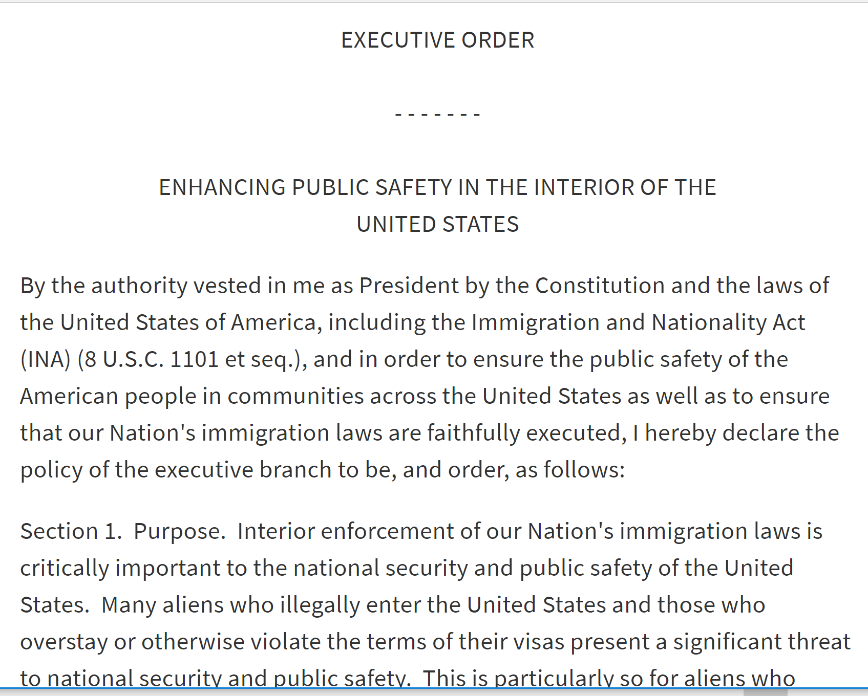
Jan. Executive Order: Enhancing Public Safety in the Interior of the United States
https://www.whitehouse.gov/the-press-office/2017/01/25/presidential-executive-order-enhancing-public-safety-interior-united

Slide 60
What is a sanctuary school district?
Under the Jan. 25 Executive Order, the current Administration specifically identifies “sanctuary jurisdictions” as those that may lose eligibility for federal grants.
However, there is no common definition of a “sanctuary” jurisdiction. It depends on the jurisdiction and context.
This is a political, not a legal term; it means different things to different people.

Slide 61
How real is the potential for loss of federal funds?
At first glance, the Jan. 25 Executive Order seems to implicate only federal grants related to law enforcement.
If the EO is read broadly, this is a very complex question under Tenth Amendment. Notice problems.
It is generally understood that the federal government cannot require states to assist with federal law enforcement, absent contractual obligation.
Because most federal funds for schools come through congressional appropriation, substantive changes would require congressional approval.

Slide 62
April 25, 2017, Federal court ruling on EO…
City and County of San Francisco v. Trump, Case No. 3:17-cv-00485-WHO (N.D. Cal.).
County of Santa Clara v. Trump, Case No. 5-17-cv-00574 (N.D. Cal.).
Federal judge issued a nationwide injunction of the part of the President’s Jan. 25th EO, prohibiting the withholding of federal funds from jurisdictions that refuse to cooperate with immigration authorities.
In May, AG Sessions issued a memo saying grants will only be withheld from jurisdictions that are not in compliance with Section 1373.

Slide 63
July 25, 2017 – New Conditions on Edward Byrne Memorial Justice Assistance Grants
Attorney General Sessions issued a press release announcing DOJ had posted a solicitation for the Byrne JAG program with new conditions requiring increased information sharing federal, state, and local law enforcement.
Chicago announced a law suit, request for preliminary injunction Monday, August 7, challenging the conditions.

Slide 64
Sanctuary vs. Plyler
Sanctuary can be politically loaded term.
May subject school district to federal action/scrutiny.
May overpromise deliverables. (i.e., ICE access; FERPA)
Plyler is the law of the land.
Recognizes broad constitutional right of access, including potential chilling effect of anti-access policies.
Represents legal over political choice.

Slide 65
What if ICE comes to my school district?
October 2011, Immigration & Customs Enforcement issued its “Sensitive Enforcement Location” policy.*
ICE “enforcement action at or focused on a sensitive location … must have prior approval” from senior DHS officials.
Sensitive location includes schools.
But, enforcement action can happen under exigent circumstances.
And, ICE can still obtain records, documents and similar materials from officials or employees, provide notice to officials or employees, and serve subpoenas.
*Memorandum from John Morton, U.S. Immigration and Customs Enforcement Director, to Field Office Directors et al., Policy No. 10029.2 (Oct. 24, 2011), available at
https://www.ice.gov/doclib/ero-outreach/pdf/10029.2-policy.pdf

Slide 66
Basics for Schools
Determine district policy.
Speak in terms of Plyler where possible.
Be sure staff is clear on when to share information. Remind them, when in doubt, STOP and call your COSA attorney!
Communicate policies to your schools, students and families.
Respond to concerns and document.
Prepare in advance for media coverage.

Slide 67

NEW!
NSBA/COSA
Resource
https://www.nsba.org

Slide 68
Resources

Slide 69
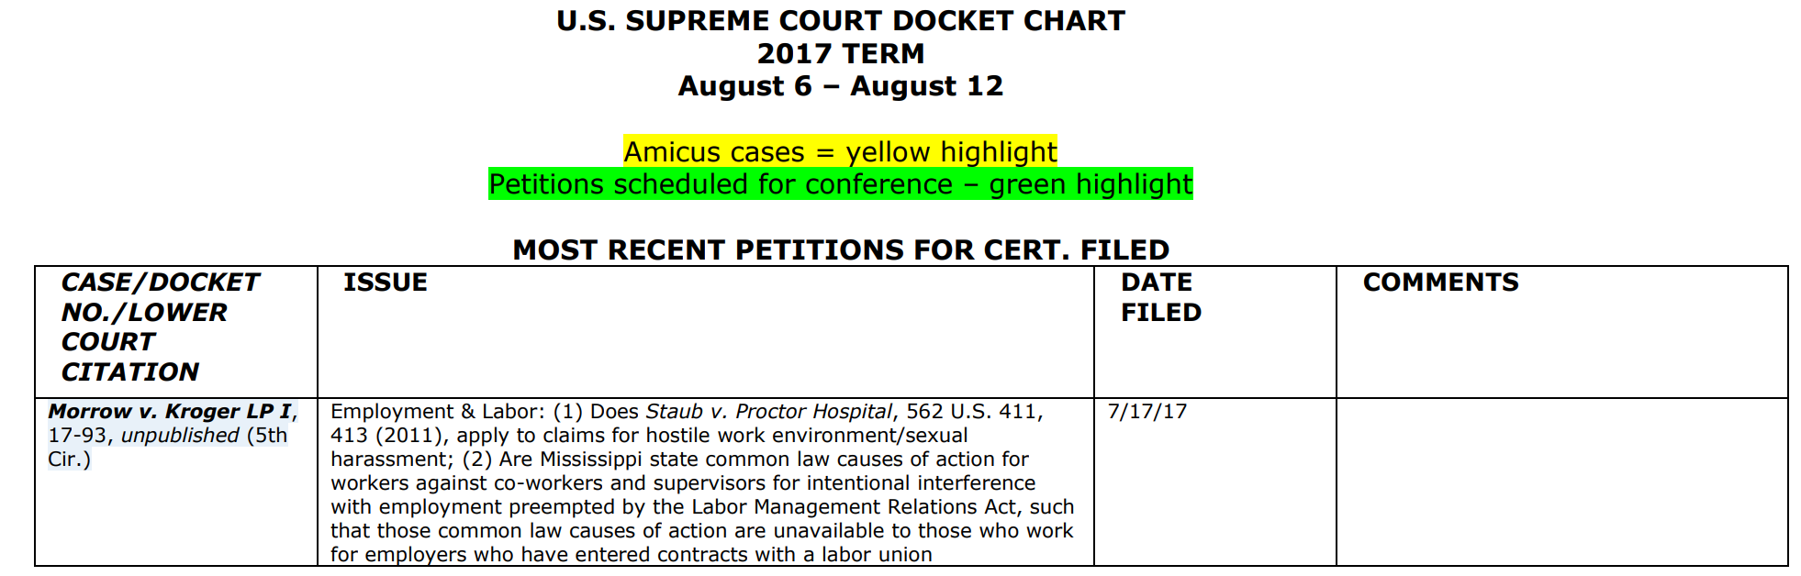
Supreme Court Charts
NSBA/COSA Resource
https://www.nsba.org/us-supreme-court-docket
https://www.nsba.org/abbreviated-us-supreme-chart

Slide 70
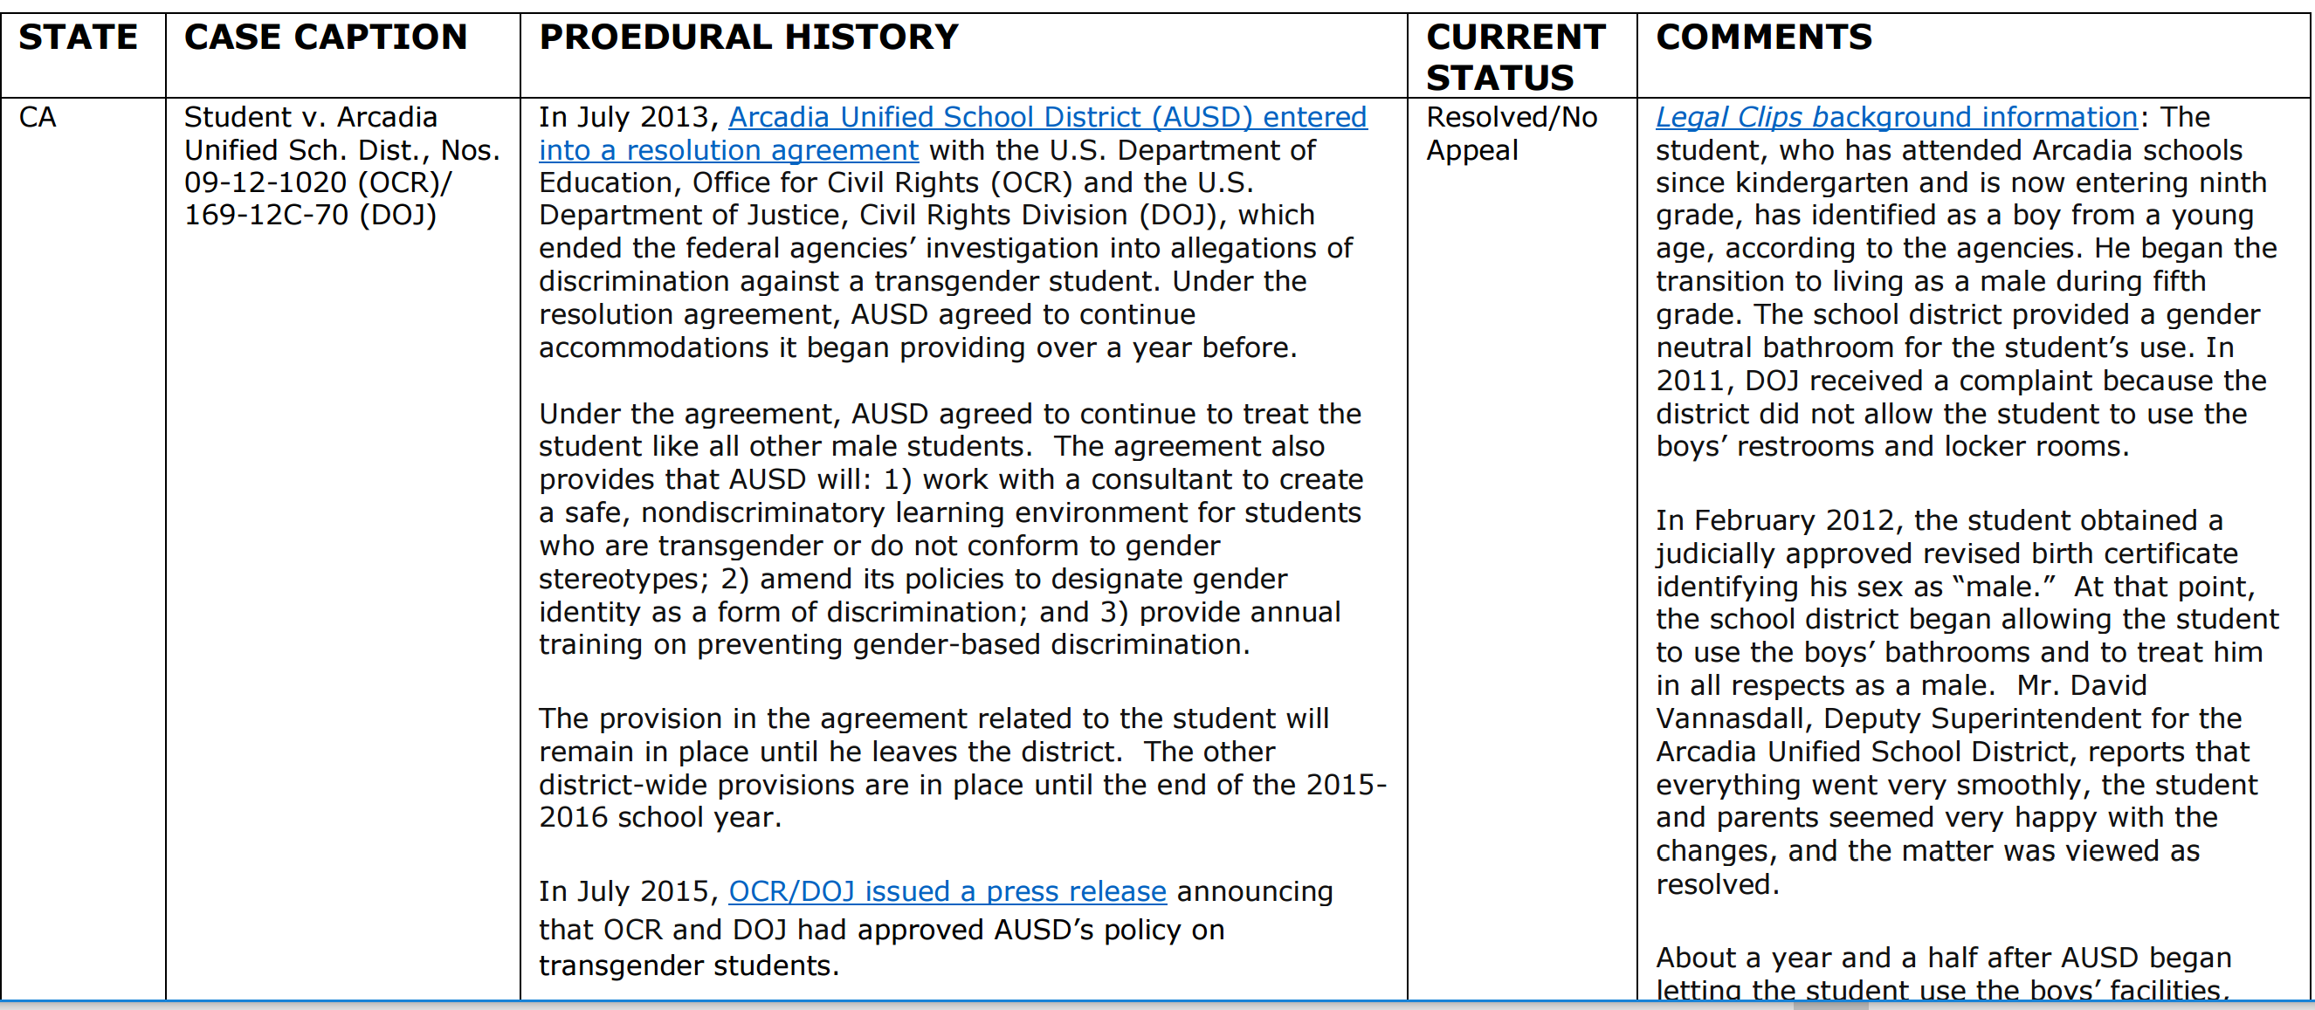
NSBA/COSA Resource
Transgender Student Litigation Chart
Available to COSA Members
https://www.nsba.org/transgender-litigation-chart
Notes:
First released in April 2016 and we’re on Version 10.0! (March 9, 2017)
COSA members have access to transgender student litigation chart

Slide 71
Working with and through our State Associations, to advocate for equity and excellence in public education through school board leadership.

